Slide 1


Slide 2

“I define connection as the energy that exists between people when they feel seen, heard, and valued; when they can give and receive without judgment; and when they derive sustenance and strength from the relationship.”
Brene Brown

Slide 3
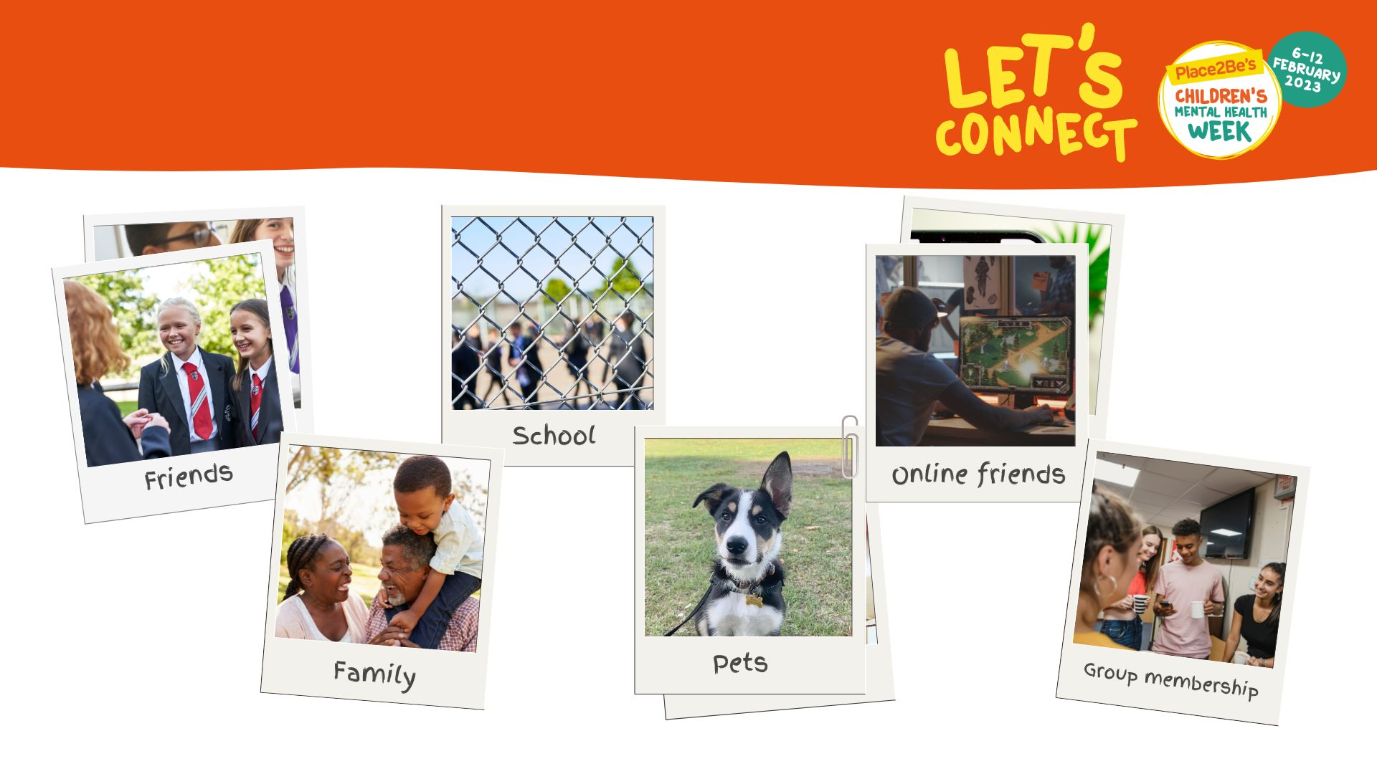
Important connections to us

Slide 4

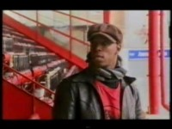
Watch this video: https://www.youtube.com/watch?v=omPdemwaNzQ

Slide 5

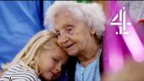
Staying connected in difficult times
Watch this video: https://www.youtube.com/watch?v=0JXnHhLT7-I&t=

Slide 6
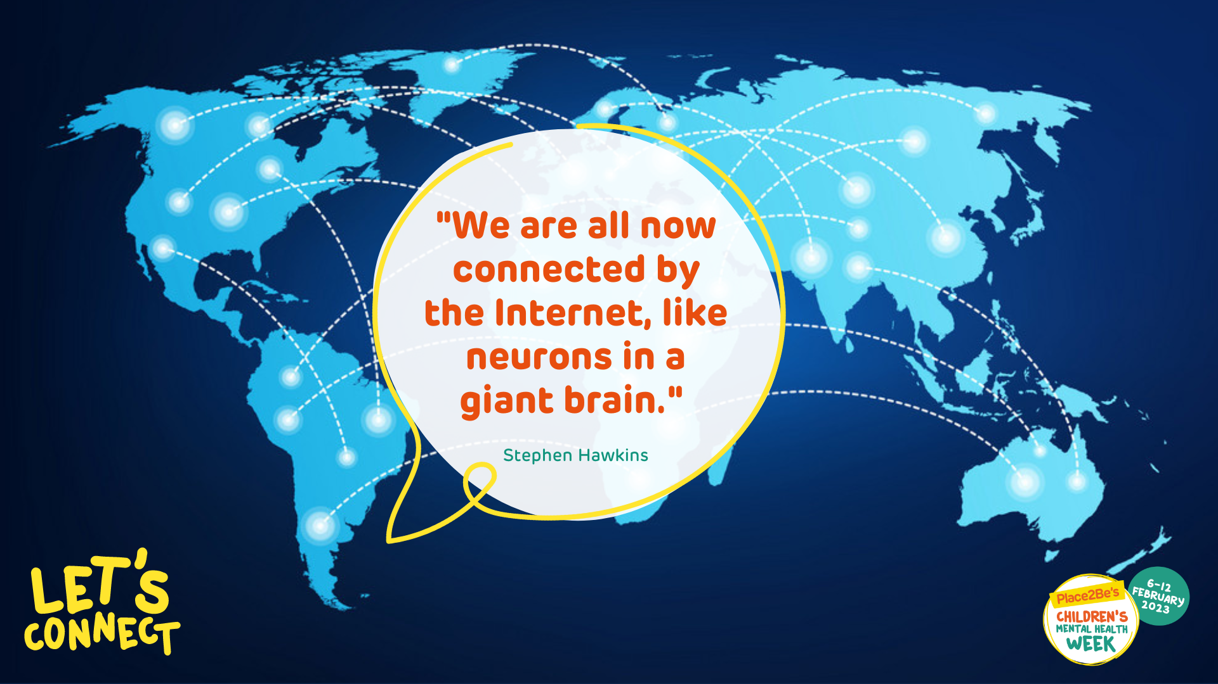

Slide 7
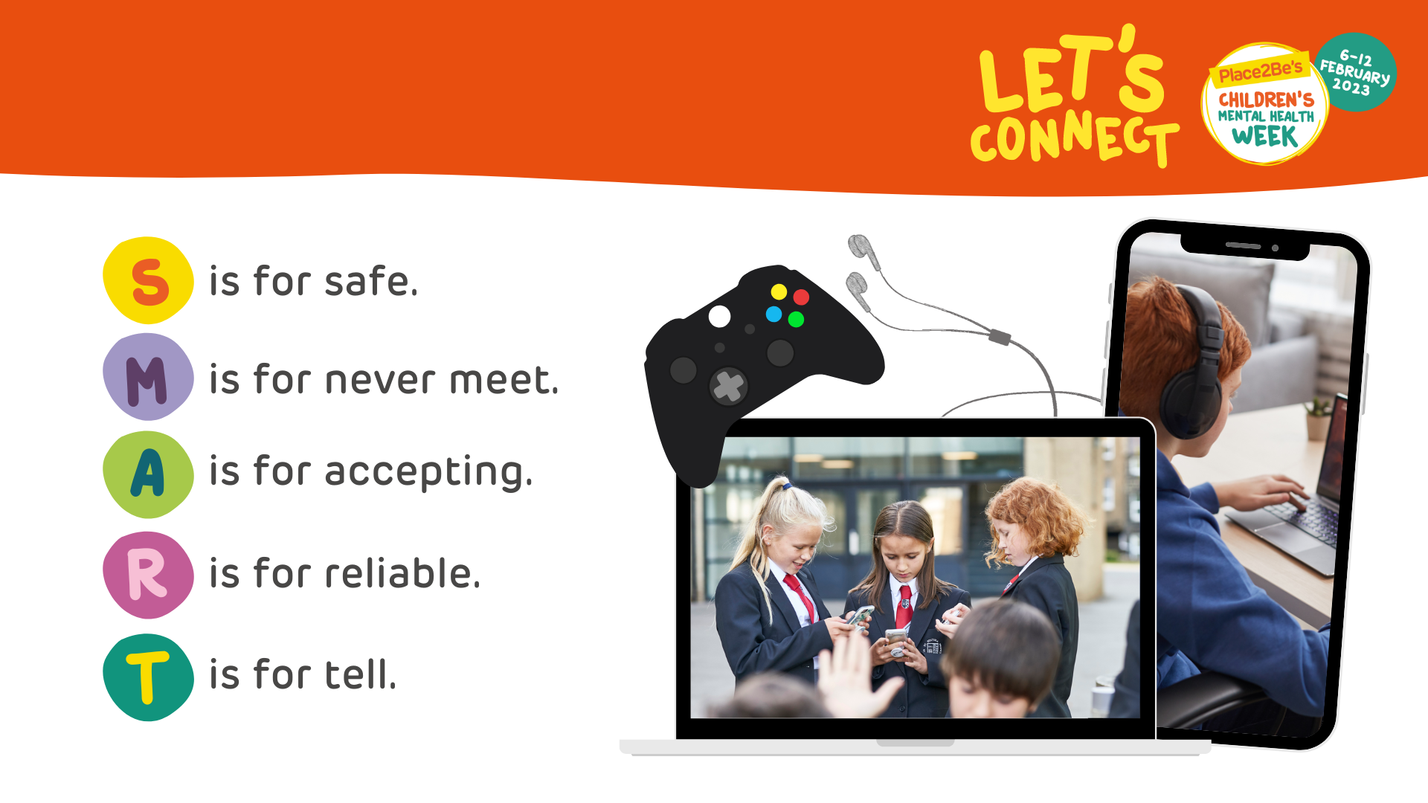
Connecting safely online

Slide 8

How can we connect more?
Notes:
Finish with song / poem of choice

