Slide 1

Kendrick School Sports Awards Presentation
Wednesday 12th June 2019

Slide 2
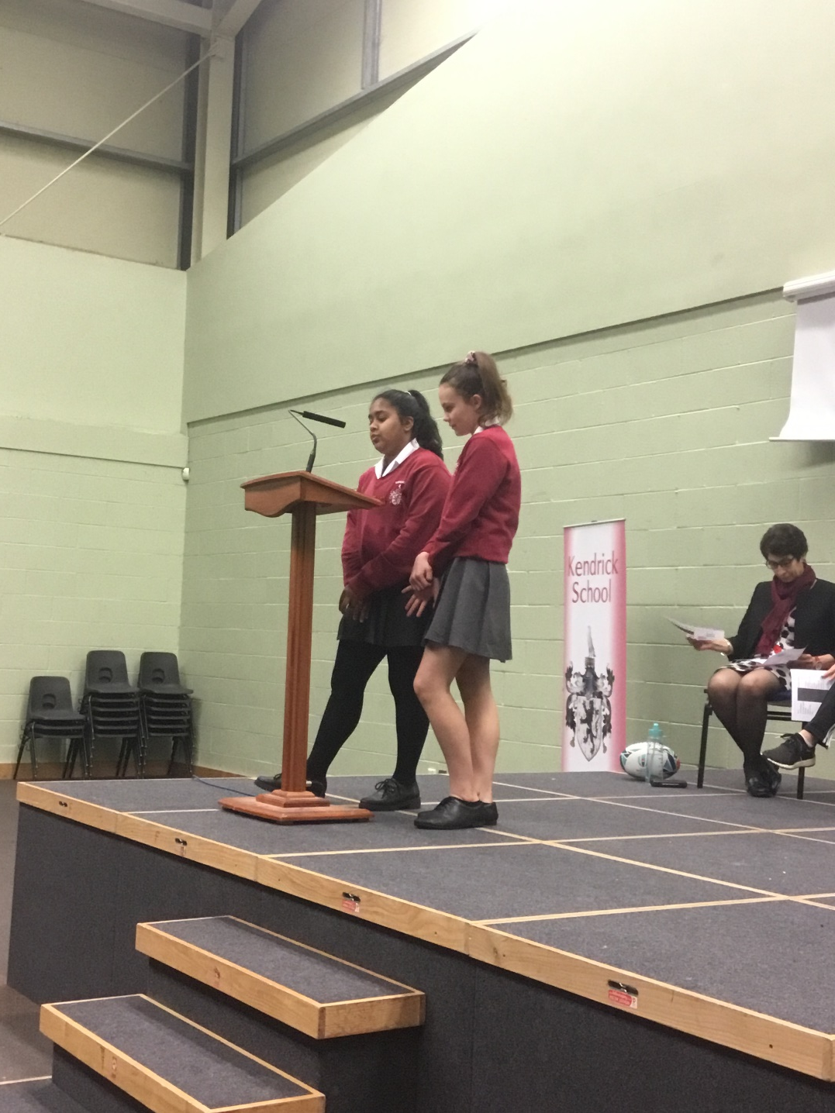

Kendrick School Sports Awards – June 2019

Slide 3

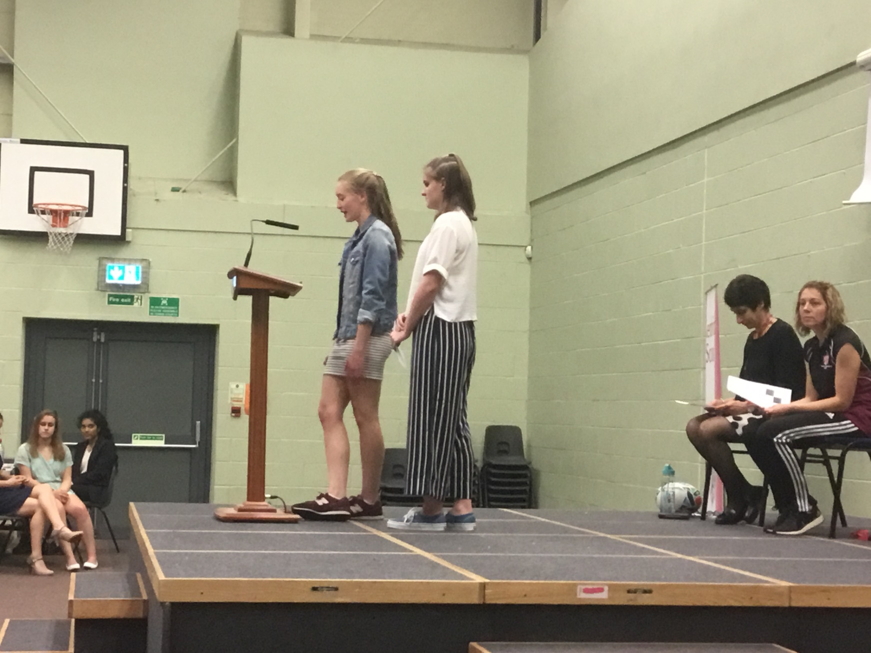
Kendrick School Sports Awards – June 2019

Slide 4
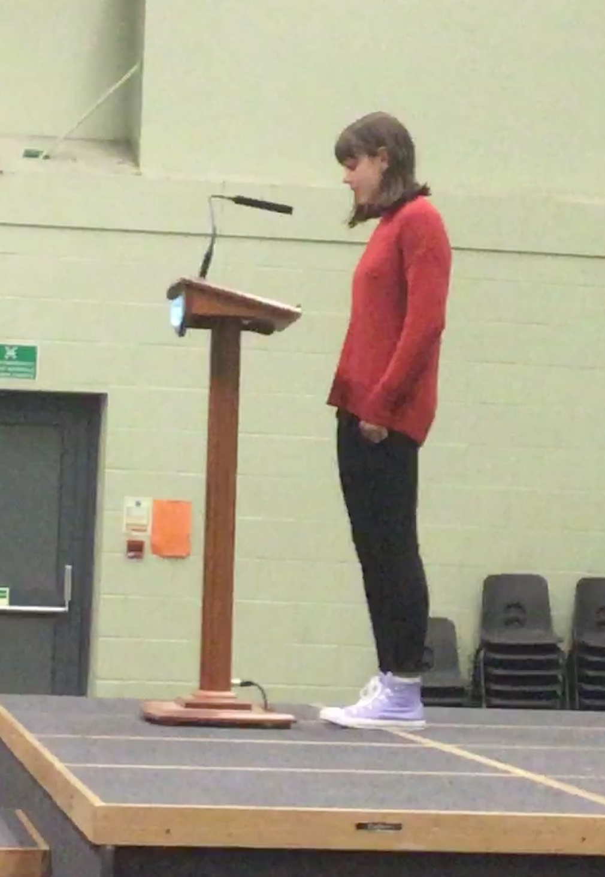

Kendrick School Sports Awards – June 2019

Slide 5
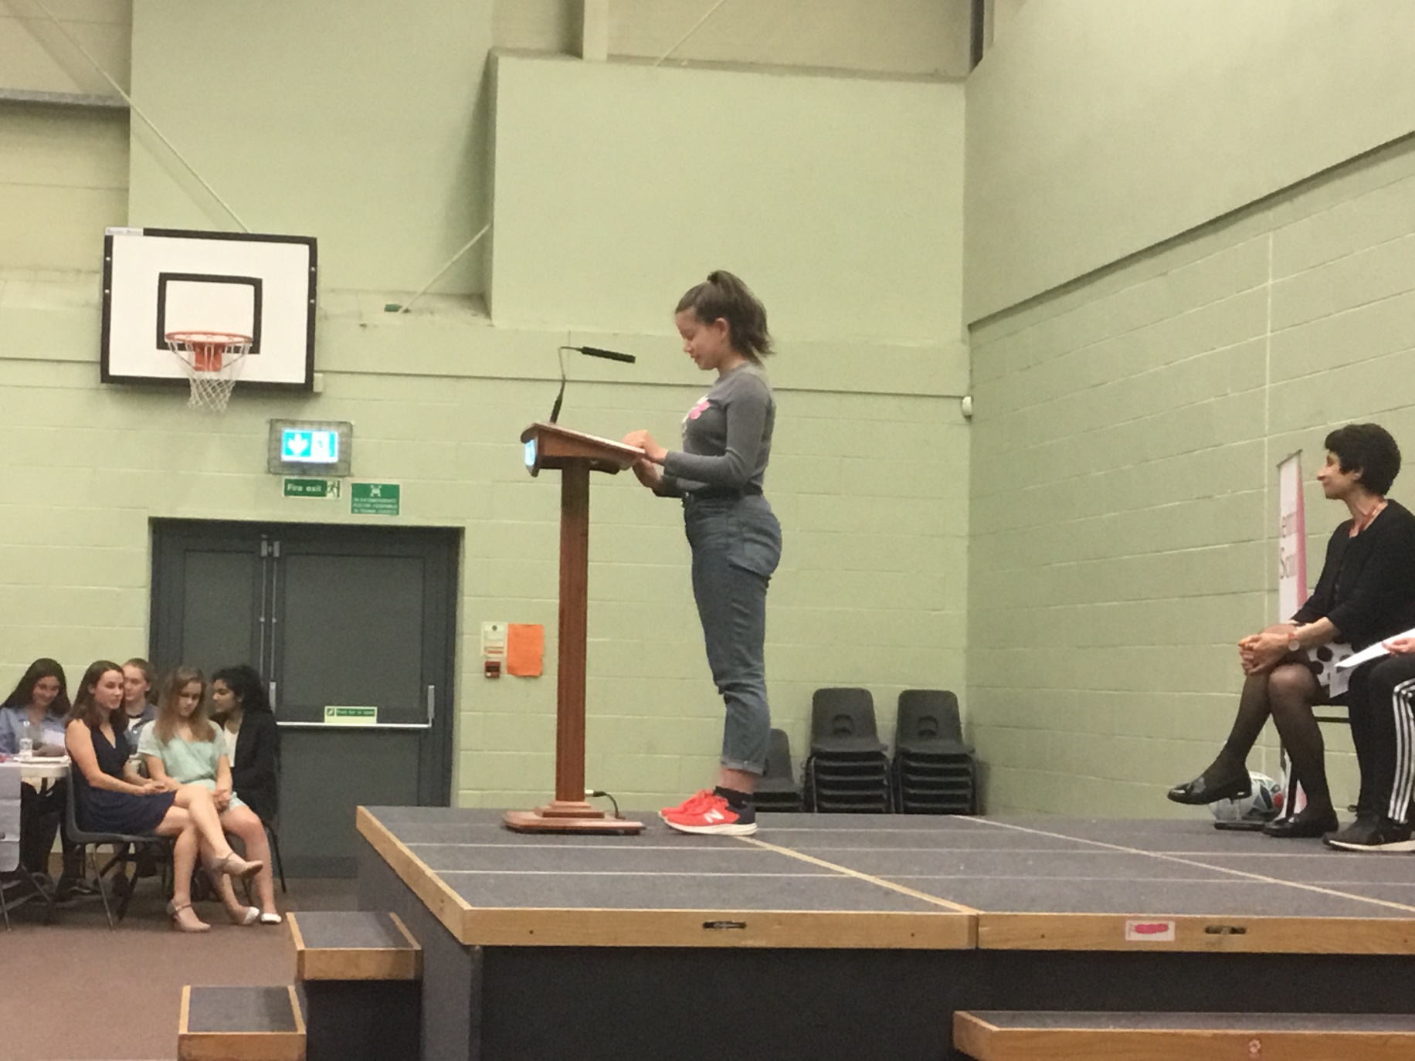
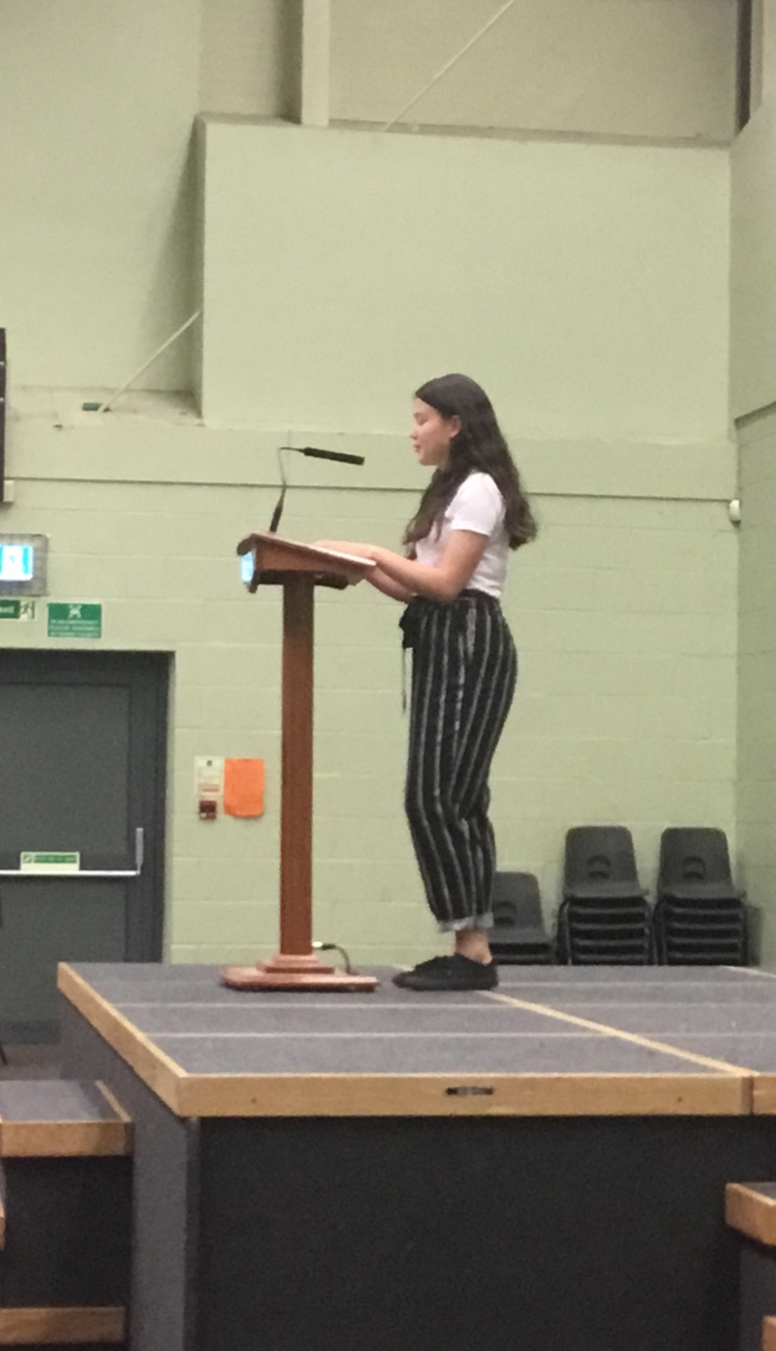
Kendrick School Sports Awards – June 2019

Slide 6
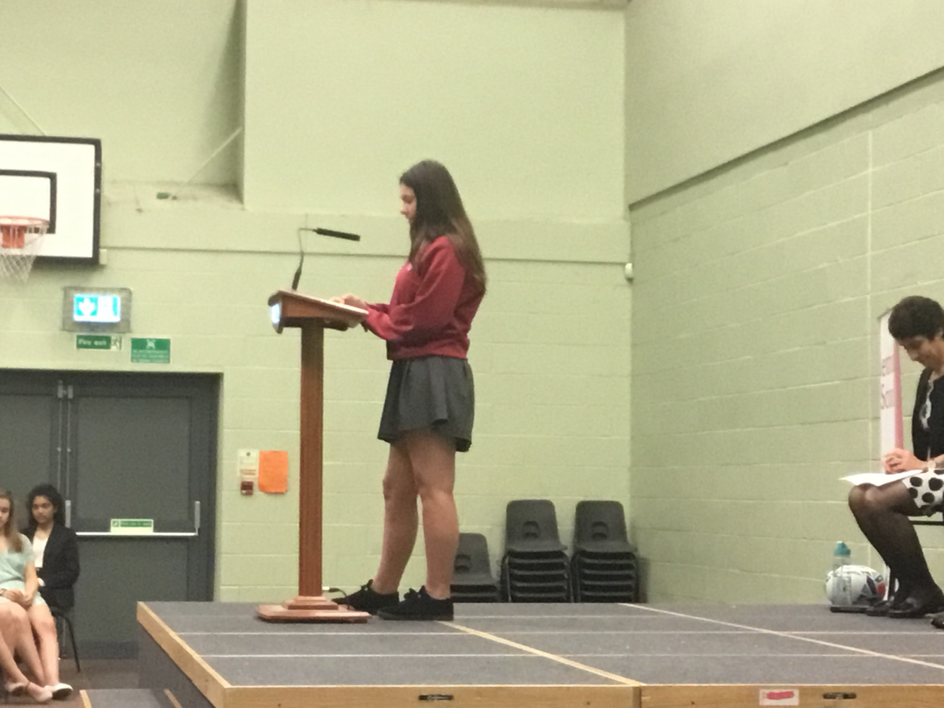

Kendrick School Sports Awards – June 2019

Slide 7


Kendrick School Sports Awards – June 2019

Slide 8

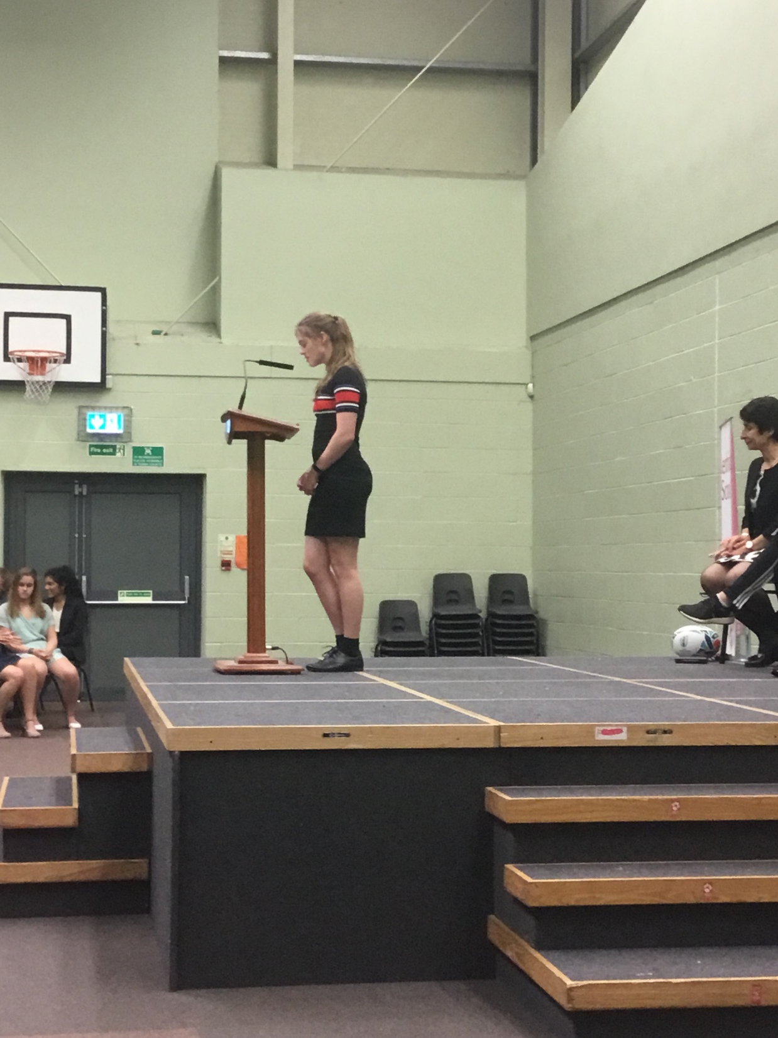
Kendrick School Sports Awards – June 2019

Slide 9


Kendrick School Sports Awards – June 2019

Slide 10

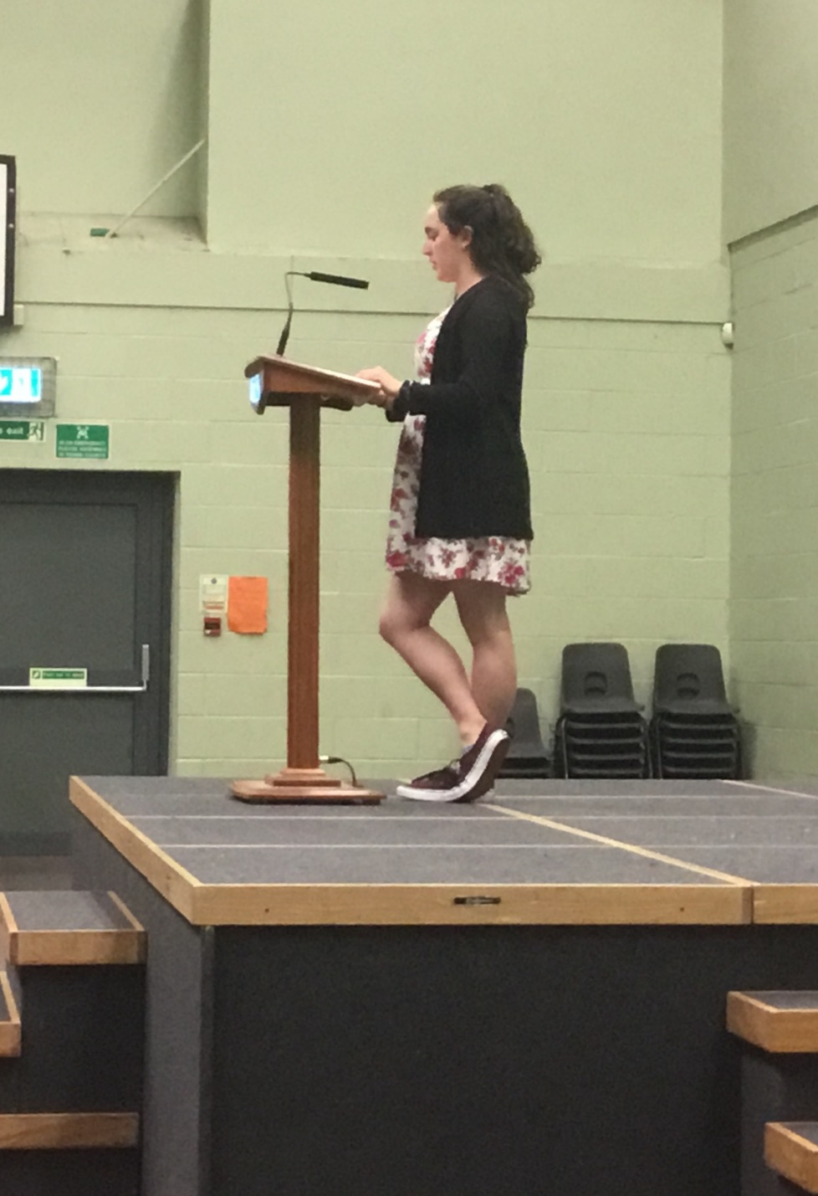
Kendrick School Sports Awards – June 2019

Slide 11
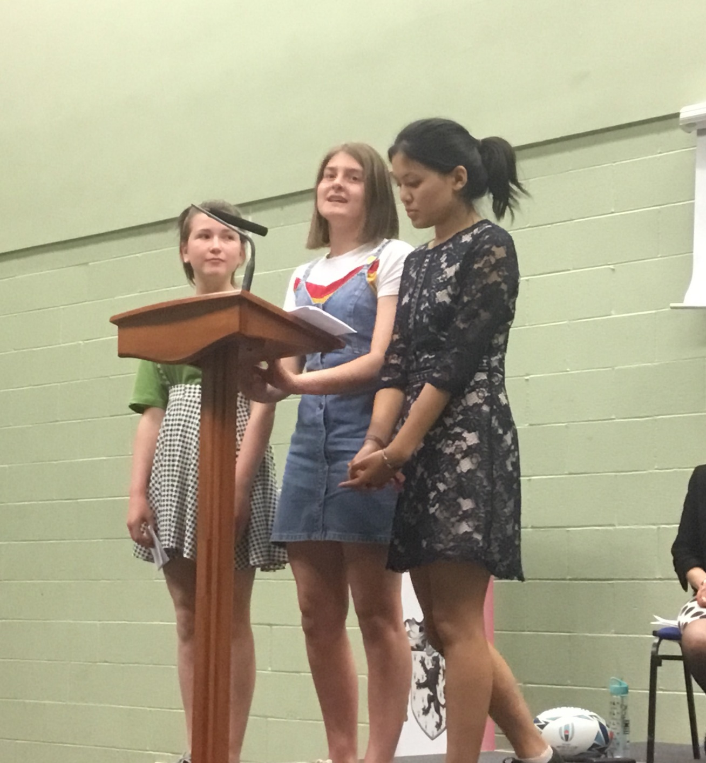

Kendrick School Sports Awards – June 2019

Slide 12

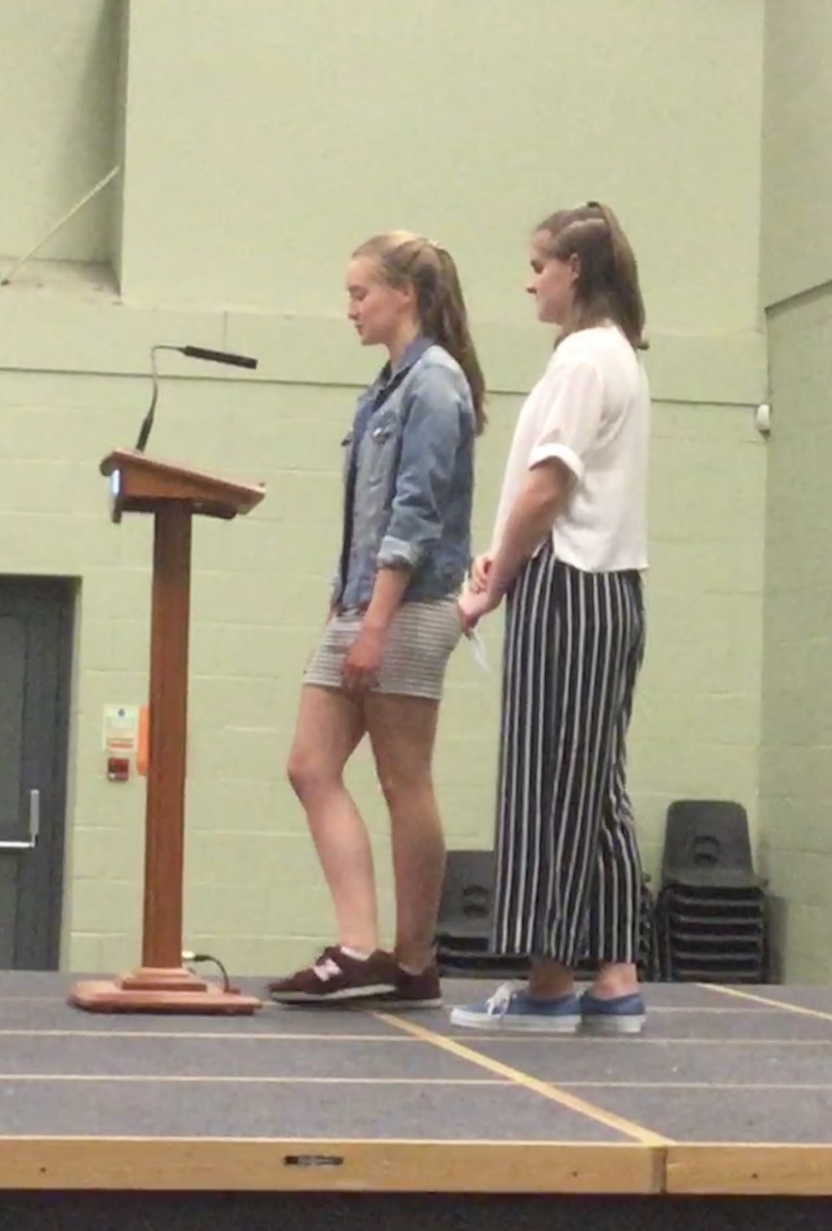
Kendrick School Sports Awards – June 2019

Slide 13


Kendrick School Sports Awards – June 2019

Slide 14


Kendrick School Sports Awards – June 2019

Slide 15
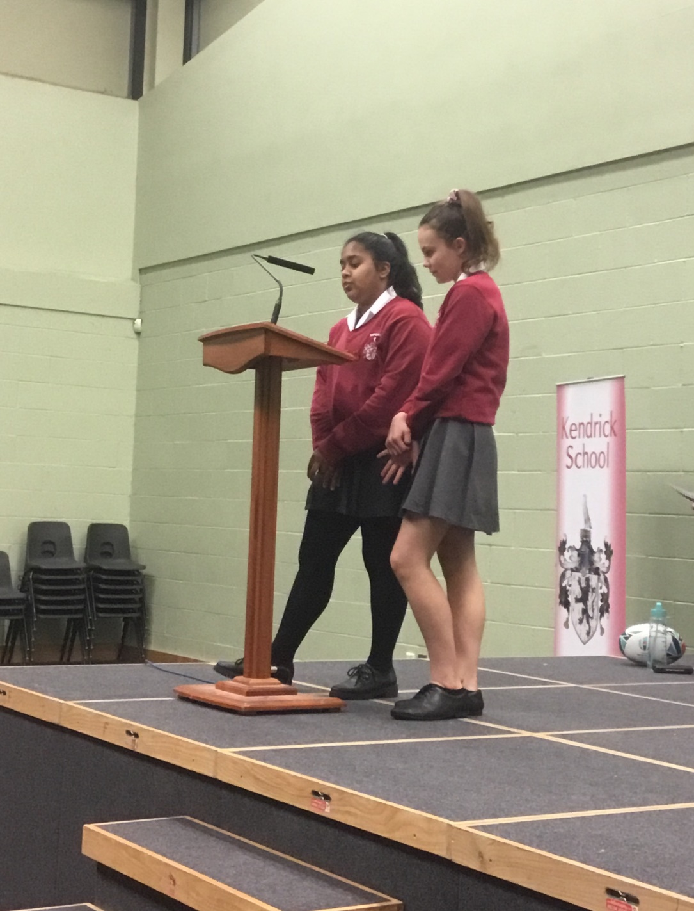

Kendrick School Sports Awards – June 2019

Slide 16
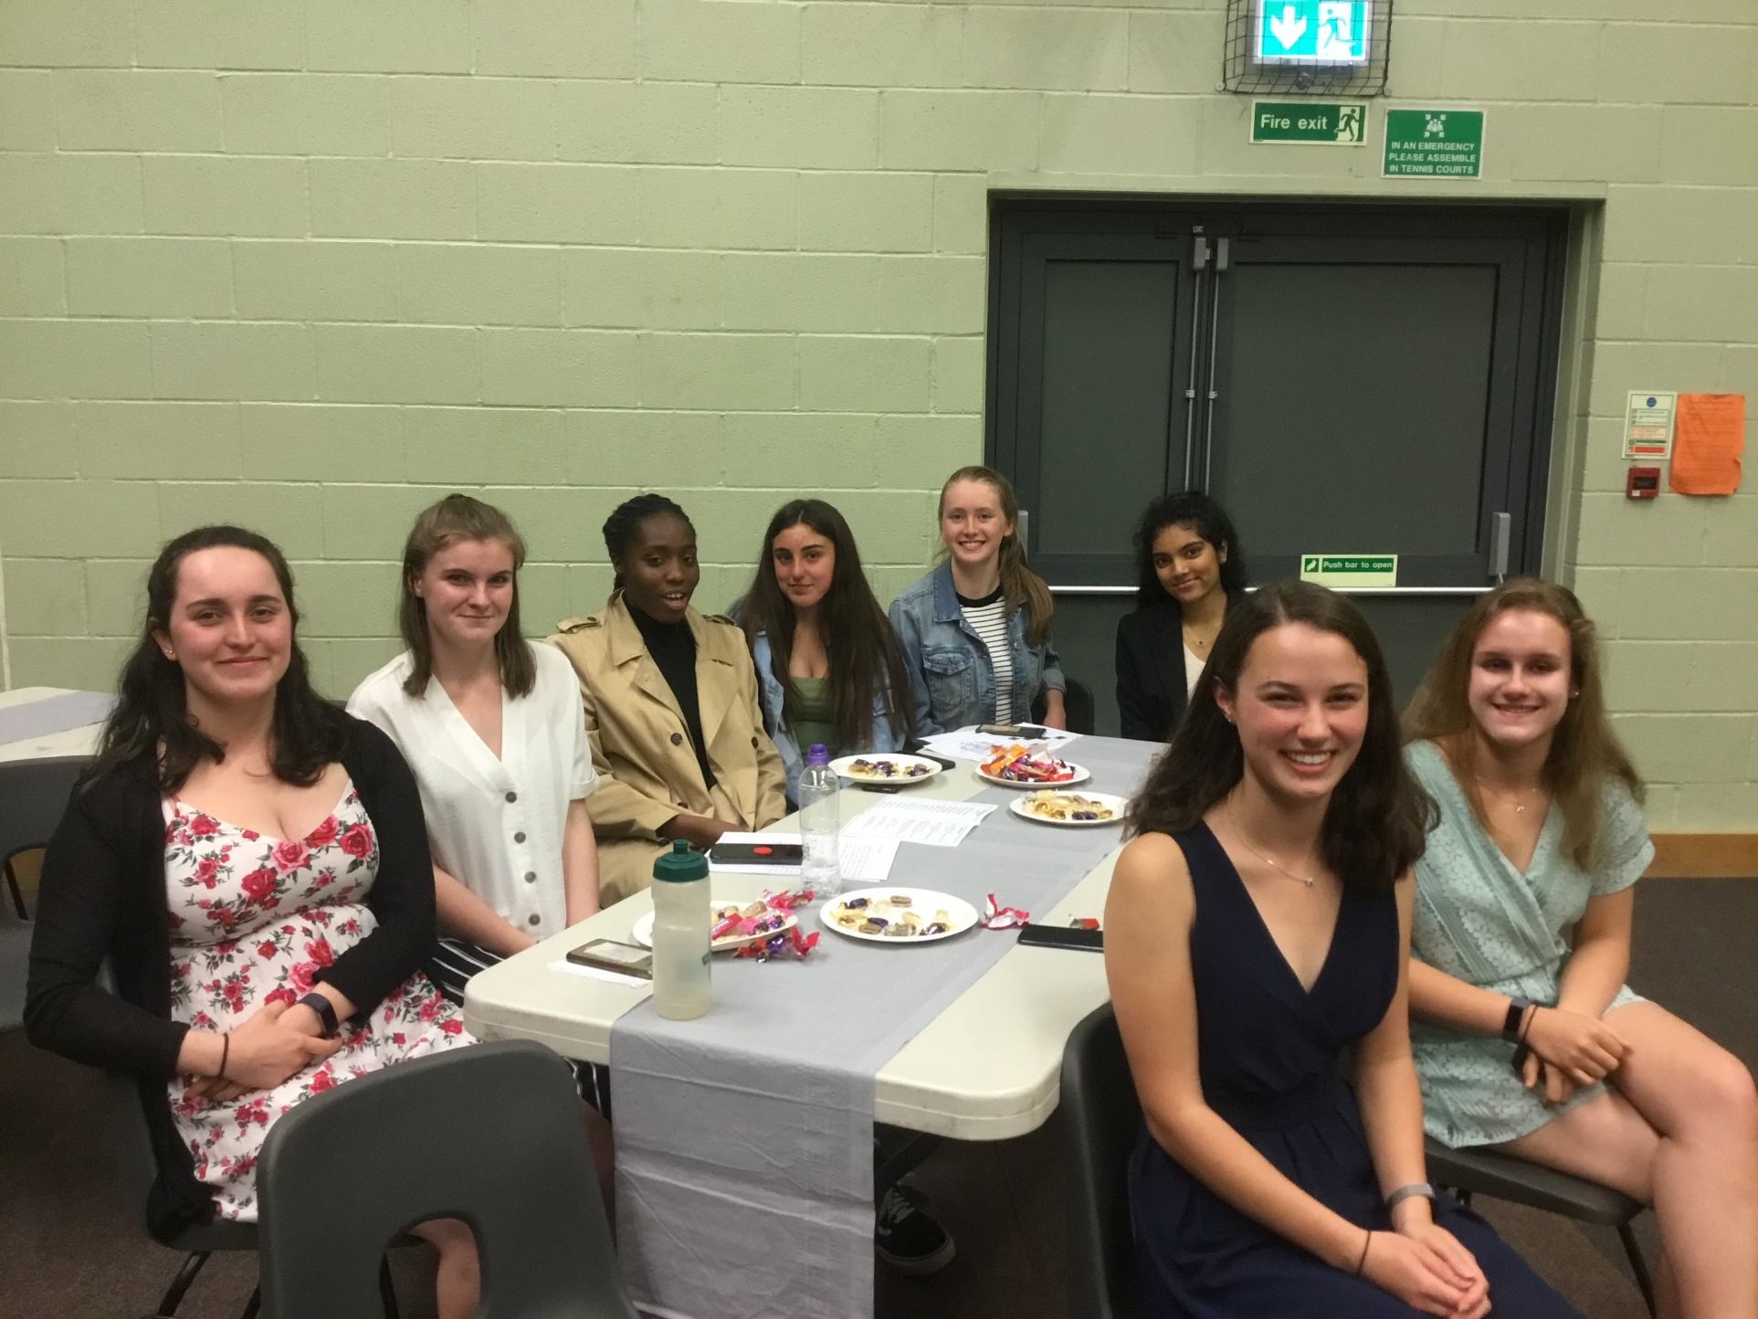
Kendrick School Sports Awards – June 2019

Slide 17


Kendrick School Sports Awards – June 2019

Slide 18


Kendrick School Sports Awards – June 2019

