Slide 1


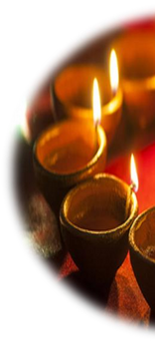

Diwali
Website: www.hindueducationboarduk.org
Email: info@hindueducationboarduk.org
©Hindu Education Board UK

Slide 2

© Hindu Education Board UK, 2025. All rights reserved. This presentation and its contents, including text,
images and scriptural references, are the intellectual property of the Hindu Education Board UK. No part may be reproduced, distributed, or transmitted in any form or by any means without prior written permission, except for educational use within UK schools with appropriate attribution.
For permissions or inquiries, please contact:
info@hindueducationboarduk.org

Slide 3

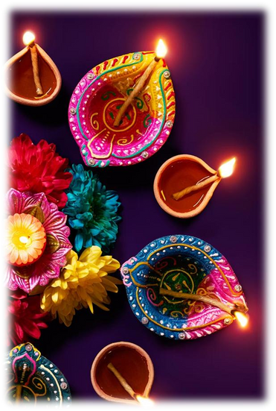

Diwali, Deepavali, Dīpāvali or Divali is derived from Sanskrit word “Deepavali” means ROW OF LIGHTS. Often called the
festival of lights
One of the major festivals celebrated by Hindus, Jains, Sikhs and Buddhists
Diwali is celebrated during the Hindu
month Kartika (between mid-October and mid- November)

Slide 4
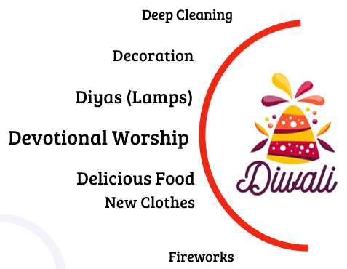
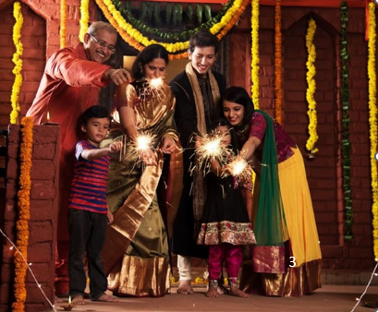
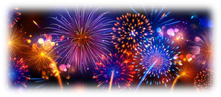
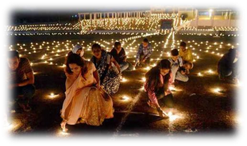
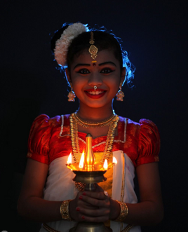
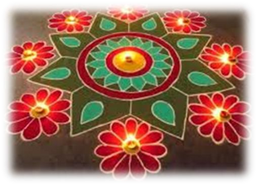
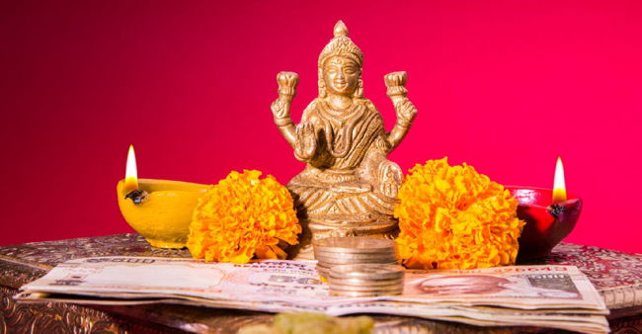
How is Diwali Celebrated?
To prepare for Diwali, celebrants will decorate their homes and workplaces with diyas (oil lamps) and rangolis (colourful, circular, artistic patterns). During Diwali, people celebrate in many ways. A few of them are:
•
Performing worship ceremonies to Lakshmi (the Goddess of prosperity and wealth)
• Wearing fine traditional clothes
• Partaking in family feasts, where sweets and gifts are shared
• Diwali festivities include a celebration of sights, sounds, arts, and flavours
• The festivities vary between different regions
• Diwali is also a major cultural event for the Hindu, Sikh, Jain, and Newar Buddhist diaspora

Slide 5

Symbolism of Diwali
Why is Diwali Celebrated?

Slide 6
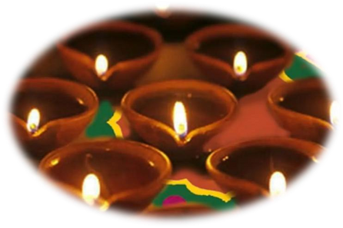
Why is Diwali Celebrated?
Historically
Diwali is a celebration that commemorates the homecoming of Shree Rama, Devi Sita, and Shree Lakshmana to Ayodhya. They had spent fourteen years in exile and successfully defeated Ravana of Lanka.
Spiritually
Diwali is a celebration of the triumph of light over darkness, Satya (truth) over Asatya (untruth), and knowledge over ignorance.
● The light symbolises knowledge and wisdom.
● Darkness is a symbol for negative forces, such as evil, violence, envy, injustice, greed, oppression and suffering.
● Thus when the lower nature in us is conquered, and we maintain the higher values of life and come to live, there is a realisation of divinity from within.
● When light prevails, there is peace and harmony for one and all.

Slide 7

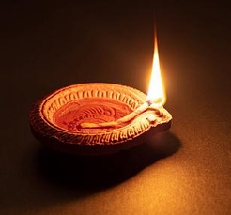

The symbolism of a Diya during Diwali
“Diya” or “Dīpa” is a small oil-filled lamp
What Does the Oil in Diyas Represent?
The oil that is used to light the Diyas represents all the negative human qualities, and that includes hatred, jealousy, greed, lust, anger, and others. The wick represents our inner self, the soul.
The lighting of Diyas symbolises that we need our mind to be clear from these negative things by enlightening our Inner Self. The disappearing oil of the Diyas symbolises the disappearance of negativities from the home. It also symbolises that enlightenment emerges only when we stride on the path of righteousness, just as Lord Rama did.
What Does Diya Symbolise?
An ignorant person will often keep themself in a dark place in their mind. They can stay connected with the positivity of the surroundings only when they realise this through knowledge. A Diya symbolises the flame of knowledge that will remove ignorance. A Diya also signifies the light and positivity that it spreads in the home. It is a normal practice in the Hindu community where people light diya in their homes every evening. It signifies the surrender of one's soul to the almighty, just like a wick is absorbed into the bright light of the flame. It shows us the path of gaining knowledge and enlightening ourselves.
deeper meaning….

Slide 8

How Diwali is celebrated in different Dharmic faiths

Slide 9
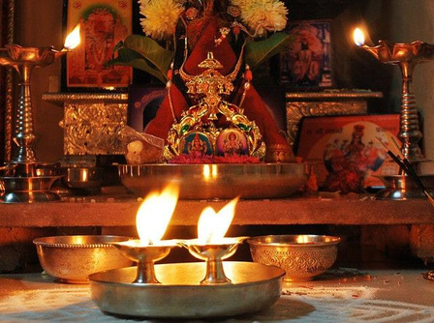

Hinduism
For Hindus, Diwali is celebrated over a course of 5 days. The main Diwali day is the day when Ram, Lakshman and Sita returned from their exile of 14 years and Hindus light diyas on this day.
Hindus celebrate this historical moment as a victory of good over evil.
The Goddess Lakshmi is worshipped . She is the Goddess of wealth, fortune and prosperity. Ganesh is the lord of intellect and wisdom, and he is revered as the remover of obstacles. He is also remembered and worshipped during this festival.

Slide 10
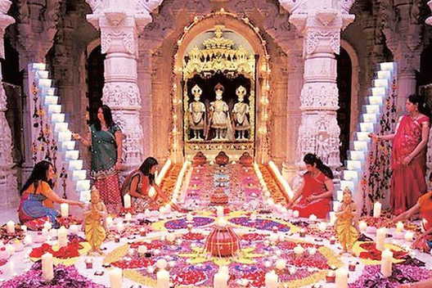
Jainism
It is a celebration of Lord Mahavir’s teachings
and his contributions to the religion and to greater humanity.
His teachings promote compassion and
justice through ahimsa (non-violence),
advocating the importance of all living beings.
Jains offer prayers to Lord Mahavira and place
lights to mark his passage and to keep his
knowledge alive.

Slide 11
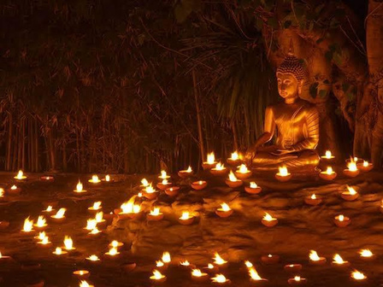
Buddhism
Diwali is the auspicious day on which Emperor
Ashoka decided to follow the path of Buddhism. Buddhists celebrate both Buddha as well as Emperor Ashoka on Diwali. Diwali marks Emperor Ashoka’s decision to follow the path of peace.

Slide 12
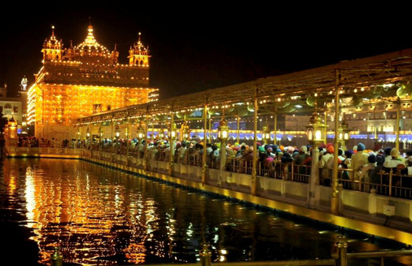
Sikhism
For Sikhs, Diwali is really important not just
for its spiritual significance but it is also marked to celebrate the release from prison of the sixth guru, Guru Hargobind, and 52 other princes in 1619.
The Moghul Emperor, Jahangir, had kept the sixth guru as a political prisoner because he was afraid of the Guru's growing power as the number of his followers grew.
Sikhs celebrated the return of Guru Hargobind by lighting the Golden Temple and this tradition continues today.

Slide 13

The Five Days of Diwali

Slide 14
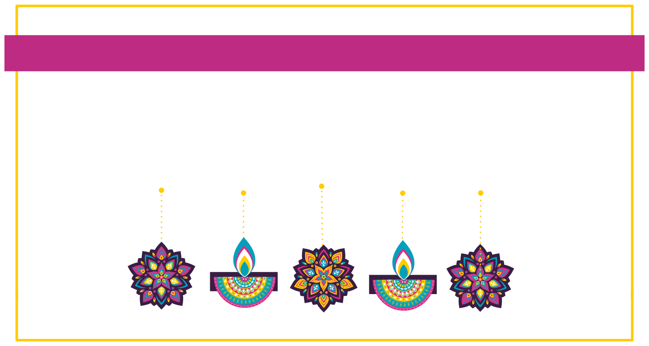
Days of Diwali
03
01
02
04
05
Bhai
Lakshmi
Dhanteras
Choti
Diwali
Puja
Govardhan Puja
Dooj
(Kali Chaudas)
New Year on a Hindu Calendar

Slide 15

(Dhanatrayodashi)
Dhanteras is a symbol of annual renewal, cleansing and an auspicious beginning for the upcoming new start.
On this day, wealth is worshipped. The word dhanteras derived from “dhan” meaning wealth and “teras” meaning thirteenth.
01
Dhanvantari - the Vaidya (physician) to the gods – came out of the Samudra Manthan (churning of the ocean) with Amrut (nectar of immortality).
Fruits of the last harvest enjoyed.
many Hindus clean their homes. They install diyas, small oil-filled lamps that they light up for the next five days.
Many people decorate their homes and offices with colourful rangoli designs.
On the evening of Dhanteras, families offer prayers (puja) to Lakshmi and Ganesha.

Slide 16

Choti Diwali (Kali Chaudas / Naraka Chaturdashi)
Marks the day when the evil king Narakasura was killed by Shree Krishna and his wife Satyabhama, thus freeing 16,000 women held in captivity.
Also known as “Choti Diwali” (small Diwali)
Choti Diwali is also a day for visiting friends and relatives and exchanging gifts.
Hanuman Puja is performed by many Hindus around the world.
02
Diwali is celebrated to mark the return of Rama to Ayodhya after defeating Ravana and completing his fourteen years of exile. Hanuman was a dedicated devotee of Ram. Therefore, people also worship Hanuman the day before Diwali's main day.

Slide 17



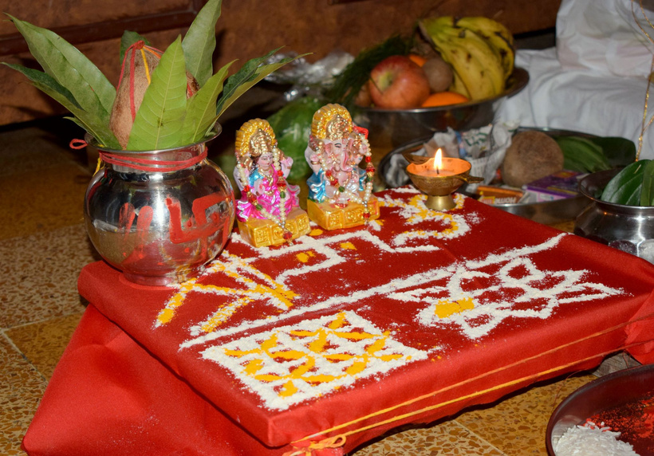

03
The main day of Diwali festival
People wear new clothes and light diyas. This symbolises that light and knowledge defeats darkness and ignorance.
Some people do fireworks to light up the sky or they make Indian sweets. On the night of Diwali, rituals across much of India are dedicated to Lakshmi to welcome her into their cleaned homes and bring prosperity and happiness for the coming year.
The day of Diwali is when Rama, Sita and Lakshman returned from exile and people lit divas outside their homes to guide their way back. Lakshmi is the consort of Vishnu. So, when Shri Rama (reincarnation of Vishnu) comes home, his consort Seeta (reincarnation of Goddess Lakshmi) comes as well. Lakshmi puja is performed to welcome her.
Footprints of Lakshmi is a very popular way to depict her arrival. Along with that, rangoli is done on the ground. Diwali, Lakshmi Puja and rangoli are all connected.

Slide 18

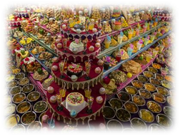
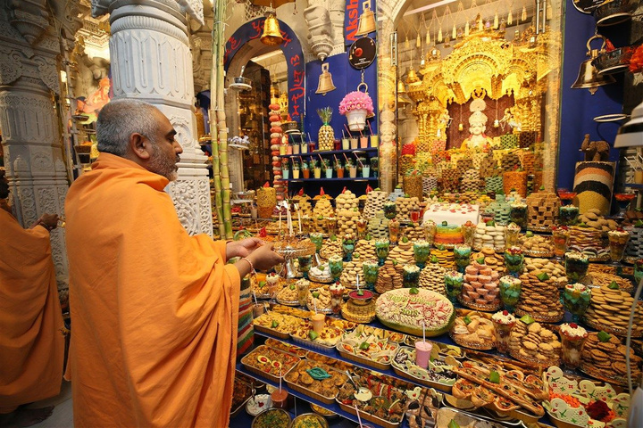
Govardhan Puja
04
This day celebrates family and community bonds, where gifts are shared. It also marks a new year on a Hindu Calendar.
In some parts of India the fourth day is celebrated as Govardhan puja, honoring the legend of the Hindu God Krishna saving the community from a big storm, which he accomplished by lifting the Govardhan mountain.
The agricultural symbolism is also observed on this day by many Hindus as Annakut, literally "mountain of food". Hindu temples prepare over one hundred dishes from a variety of ingredients, which is then dedicated to Krishna as an offering before being shared among the community.
Hindus show gratitude to the elements that provide vital sustenance for life. Is an ecologically focused celebration, where Hindus plant trees and tend to animals.

Slide 19

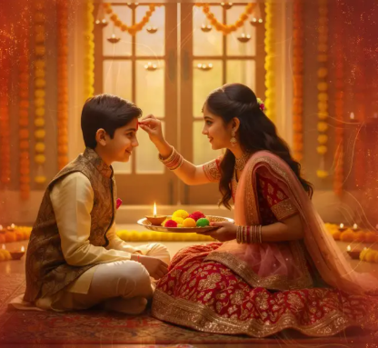
Bhai Dooj
05
Bhai Dooj is the fifth and last day observed during the Diwali festival.
On this day, sisters invite their brothers to their homes and this day is mainly focused on food and enjoying family company.
Sisters pray for their brother’s long and happy life while brothers give gifts to their sisters and promise to protect them and stand by them

Slide 20
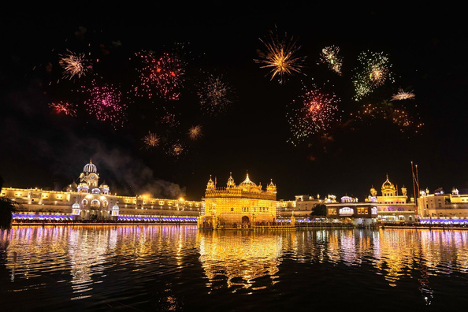
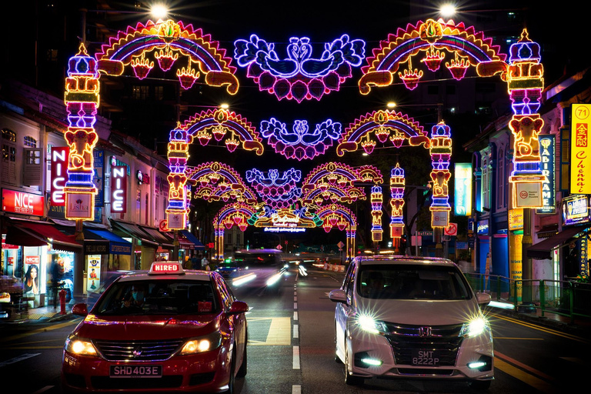
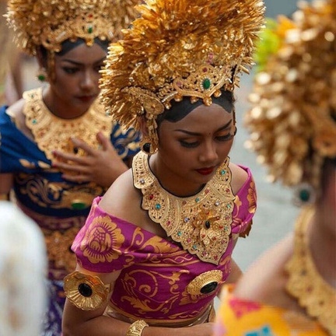
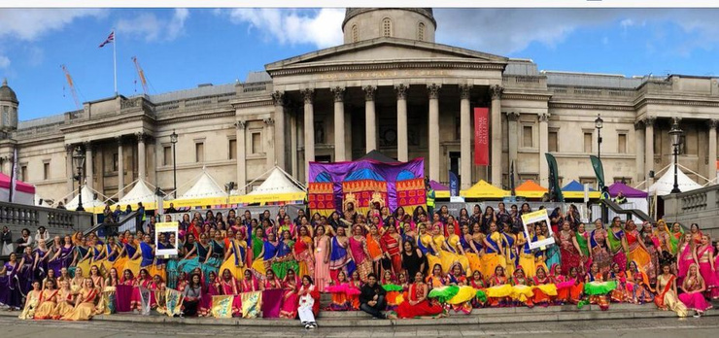

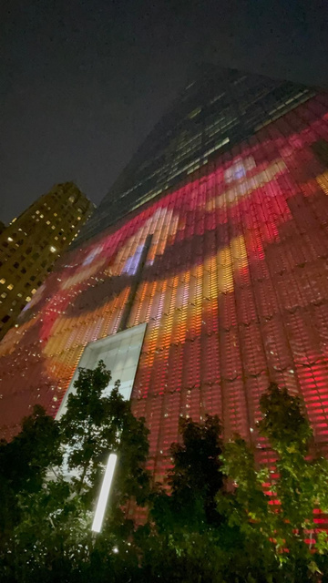
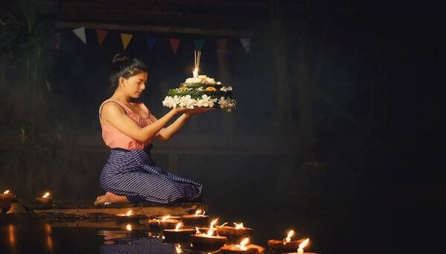
Diwali Around the World
New York
Suvarna Mandir (Golden Temple), Amritsar, India
Little India, Singapore
Indonesia
World Trade Center, Newyork
Lam Kriyongh, Thailand
Trafalgar Square, London, UK

Slide 21
Happy DiwaliTo All!
Website: www.hindueducationboarduk.org Email: info@hindueducationboarduk.org

